Slide 1

Making this resource work for you
Prior to teaching this lesson, please refer to the ‘Unit Overview and Planning Document’.
Further guidance on planning Science Mastery lessons can be found in the detailed planning guidance document.
Refer to the ‘notes’ section on each slide for useful information, including suggested expositions, pedagogical content knowledge, suggested questions, answers and more. Consider using presenter mode so you can see this guidance throughout the lesson.
The introduction slides can be adapted to suit your teaching style and the needs of your class.
Before the lesson, adapt the fix-it slide to address any misconceptions identified in the previous lesson’s exit ticket.
Choose from the suggested activities to suit your class. The intention is not that you complete all of these, but that you select those which ones are most appropriate for your students. It may be appropriate to further adapt activities for your students.
These lessons are designed to occupy approximately 1 hour. To adapt for a shorter or longer lesson duration we advise you to adapt the activity section accordingly.
Please consider using the final slide to send feedback about this lesson or examples of PowerPoints that you have adapted to our design team. Your feedback is used to improve Science Mastery for all of our teachers and students. We appreciate all suggestions and comments.
Thank you for reading!
The Science Mastery Team

Slide 2
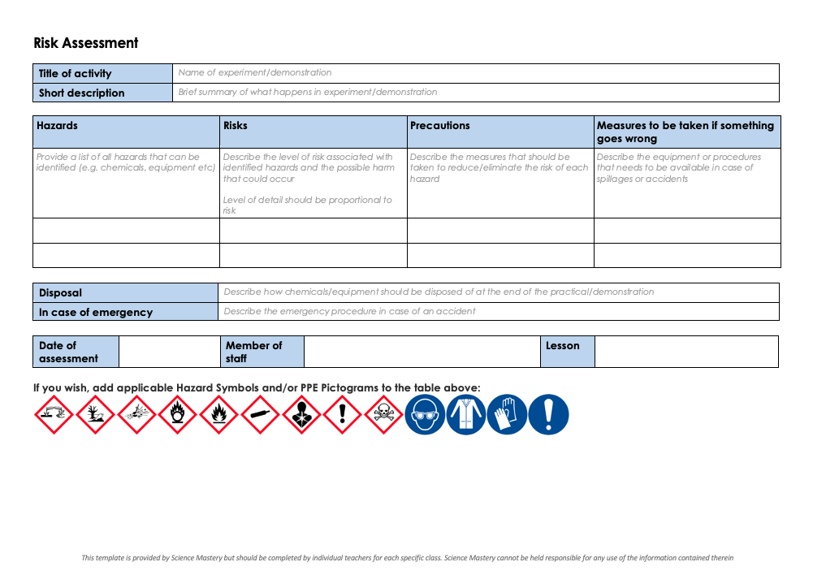
Practical Activity
This lesson contains a practical activity (either a whole class activity or a demonstration)
A risk assessment must be completed for this practical
The template risk assessment can be found here.
The risk assessment should be specific to the class involved and written only by the teaching member of staff
The risk assessment should refer to the current CLEAPSS Hazcards for all chemicals used in the practical for safety and disposal notes.
A list of chemicals used can be found in the Practical Guide
It is good practice for students to wear safety spectacles during all class practicals and demonstrations
Thank you for reading!
The Science Mastery Team

Slide 3

Extracting Less Reactive Metals
Answer the questions below.
1. What metal undergoes rusting?
2. What other substances are required for this metal to rust?
3. What is formed when a metal reacts with an acid?
4. When hydrogen gas is produced, what might be observed during the reaction?
5. Write down the symbol used to separate the reactants and products in a chemical reaction.
Iron
Water and oxygen
A salt and hydrogen gas
Bubbles (effervescence)
→
Notes:
Big idea: Reactions Rearrange Matter
Foundation: [Insert foundation level additional question]
Stretch: [Insert challenging additional question]
Answers:
Foundation: [Insert foundation level answer]
Stretch: [Insert challenging additional answer]

Slide 4
Extracting Less Reactive Metals
Do Now:
1. What metal undergoes rusting?
2. What other substances are required for this metal to rust?
3. What is formed when a metal reacts with an acid?
4. When hydrogen gas is produced, what might be observed during the reaction?
5. Write down the symbol used to separate the reactants and products in a chemical reaction.
Drill:
Write the word equation for the reaction of magnesium metal with hydrochloric acid.
The chemical formula for Magnesium chloride is MgCl. Write a balanced chemical equation for the same reaction.
Notes:
Answers:
Do Now:
1. Iron
2. Water and Oxygen
3. A salt and hydrogen gas
4. Bubbles (effervescence)
5. →
Drill:
Magnesium + hydrochloric acid → magnesium chloride + hydrogen
2Mg + 2HCl → 2MgCl + H₂

Slide 5
Extracting Less Reactive Metals
Read Now:
Africa is swiftly becoming the second largest gold mining region in the world, after China. A number of African countries are beginning to increase gold exploration, with five countries topping the list – Ghana, South Africa, Sudan, Mali and Burkina Faso. In 2021, over 680 tonnes of gold was mined in Africa (an increase of 0.5% on the previous year). So what is special about gold? Gold is a soft and dense previous metal that is the most malleable out of all metals. It is an excellent conductor of electricity. This means that it has many uses, including for jewellery, and industry.
1. Where in the world is the most gold mined each year?
2. List the five African countries that mine the most gold per year.
3. State a property of gold.
4. Describe a use of gold.
5. Calculate the mass of gold mined in Africa in 2020.
Notes:
Answers:
China
Ghana, South Africa, Sudan, Mali, Burkina Faso
Soft, dense, malleable, good conductor of electricity
Gold can be used in jewellery
Mass in 2021 = 680 tonnes. This is an increase of 0.5% on previous year, so 2020 = 680/100.5 x 100 = 676.6 tonnes

Slide 6


C4.2.2
01/10/2025
Extracting Less Reactive Metals
C4.2.1 PKR: The Reactivity Series
C4.2.2 Extracting Less Reactive Metals
C4.2.3 PKR: Ions, Ionic Bonding and Deducing Ionic Formulae
C4.2.4 (HT) Ionic Equations and Displacement Reactions
C4.2.5 (HT) Writing Half Equations
C4.2.6 (HT) Ionic Equations for the Reactions of Acids and Metals
C4.2.7 Introduction to Electrolysis
C4.2.8 Extracting Metals by Electrolysis
C4.2.9 Electrolysis of Molten Ionic Compounds
C4.2.10 Electrolysis in Solutions
C4.2.11RP: Electrolysis of Aqueous Solutions 1
C4.1.12 RP: Electrolysis of Aqueous Solutions 2
C4.1.13 TIF: Corrosion and its Prevention
C4.2.14 (HT) Obtaining Raw Materials
C4.2.15 Recycling Metals
C4.2.16 Feedback Lesson
Notes:
Big Idea: Reactions Rearrange Matter
Suggested Hook:

Slide 7

Following this lesson, students will be able to:
List metals in order of reactivity
Write equations for displacement reactions, and predict the products of these reactions
Identify substances which are oxidised and reduced in displacement reactions
Key Words:
displacement
oxidation
reduction
Notes:
Guidance:
See unit overview document and planning guidance to see how these objectives are typically assessed at GCSE, including examples of what students should be able to do following this lesson.
Planning for different needs:
The learning objectives given on this slide are suggested based on the most common requirements for exams, however they can be adapted based on the needs of different classes.
For best practice, the unit preparation booklet should be used to determine the appropriate focus of lessons within the unit.
While it is not possible to explicitly split content into levelled grades, we recommend that lesson objectives can be classified as critical, core or stretch.
Critical: the content or skill is essential for all students to be able to progress.
Core: the content or skill is important for students to progress, but other opportunities may be available to revisit it.
Stretch: the content or skill may not be essential for all students but is important for students aiming for the highest grades.
Key skill: this is a crucial skill being developed in this unit as part of the skill mapping
C4.2.2 Lesson Objectives:
Critical: List metals in order of reactivity
Critical: Write equations for displacement reactions, and predict the products of these reactions
Critical: Identify substances which are oxidised and reduced in displacement reactions

Slide 8
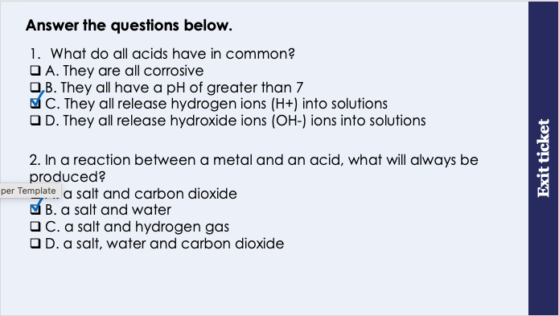
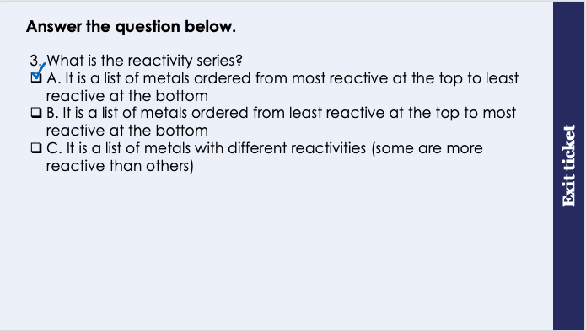
This is the fix-it portion of the lesson
The fix-it is an opportunity to respond to gaps in knowledge, especially those identified by the previous lesson’s exit ticket.
The teacher should customise this slide as needed, to facilitate
reteach, explanation, demonstration or modelling of ideas and concepts that students have not yet grasped or have misunderstood.
practise answering specific questions or of key skills.
redrafting or improving previous work.
Notes:
Fix-it guidance from previous exit ticket:
Q1. Answer: C
If students answer A, they have the misconception that all acids are corrosive. To fix-it, remind students that many common substances are acidic and not corrosive, such as lemon juice. Both acids and alkalis can be corrosive and can also be weak and non-corrosive.
If students answer B, they have mixed up the pH scale. Acids have a pH or less than 7, not greater than 7. To fix-it, ask students to label a diagram of the pH scale with the pH of strong and weak acids and alkalis.
If students answer D, they have mixed up the ions found in acidic solutions with those found in alkaline solutions. To fix-it, show students the chemical formulae of common acids, and ask them to identify the element common to all of these formulae – hydrogen. Explain that this is why acids in solutions always have hydrogen ions.
Q2. Answer: B
If students answer A, C or D, they have mixed up the reactions of acids and metal carbonates, metal hydrogen carbonates and alkali metals and water. To fix-it, ask students to fill in a table that suggests the chemical equations for a variety of different reactions. A model answer can be provided for each type of reaction.
Q3. Answer: A
If students answer B, students have mixed up the order of reactivity – it should be most reactive at the top and least at the bottom of the reactivity series. If students answer C, they have attempted to define the reactivity series, however the answer is not specific enough. To fix-it, give students a model answer to define the reactivity series. Ask them to arrange metals into a reactivity series and to explain why they decided in a particular order.

Slide 9
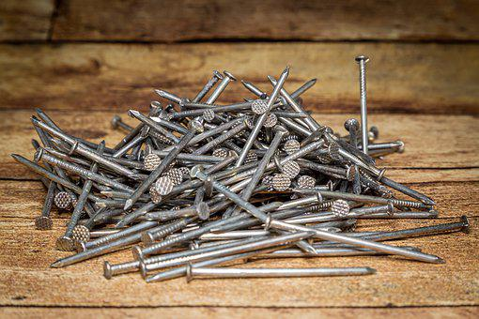
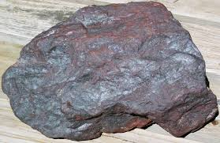
Extracting Metals
Potassium
Sodium
Iron extracted
Calcium
Magnesium
Aluminium
Carbon
Iron ore containing the mineral iron oxide
Iron metal which can be used to make a range of products
Zinc
Iron
Tin
Lead
Carbon and hydrogen can be used to extract metals from their compounds using a displacement reaction.
Hydrogen
Copper
Silver
Gold
Platinum
Notes:
Model teacher exposition:
So where do metals come from? Most metals are found inside ores. These are rocks that contain enough metal to be extracted. Once the metal is extracted we can use it to make a range of products.
Unreactive metals like gold are often found as pure metals in nature so they don’t need to be extracted.
The reactivity series helps us to predict which kinds of reactions will allow us to extract different metals from their ores. We use displacement reactions. Let’s remind ourselves, what is a displacement reaction? A reaction in which a more reactive element displaces a less reactive element in a compound.
We’ve seen these reactions before when we studied the reactions of acids. Let’s remind ourselves of these reactions now. On the board, remind students of these reactions and narrate the process of predicting the name of the salt produced when an acid and metal react.
It is useful to add carbon and hydrogen to the reactivity series because these non-metal elements can be used to extract metals.
Using your knowledge of displacement reactions, which metals in the reactivity series could be extracted using
carbon? Anything lower that carbon on the reactivity series
hydrogen? Anything lower that hydrogen on the reactivity series
Gold could in theory be extracted using both, but as we said before, gold exists as an element in nature, meaning it doesn’t need to be extracted from an ore at all.
Image source
https://www.flickr.com/photos/jsjgeology/19026398982
https://pixabay.com/photos/nails-flat-head-stole-industry-4607200/

Slide 10
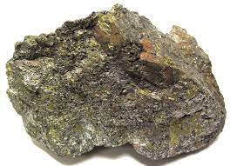
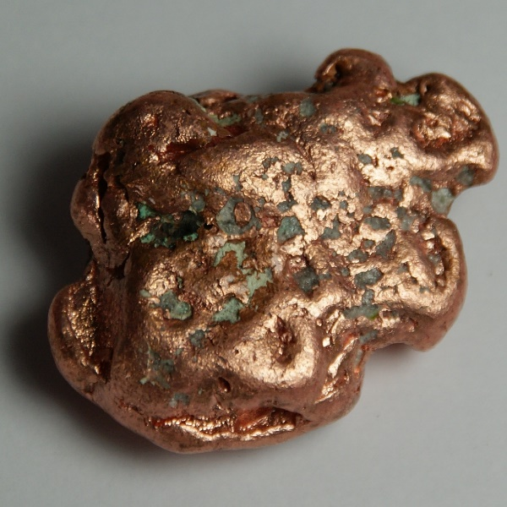
Extracting metals using carbon
Potassium
Sodium
Carbon can be used to extract metals that are less reactive than itself.
It achieves this by displacing the metal from its compound. For example, copper can be extracted from copper oxide:
copper oxide + carbon → copper + carbon dioxide.
2CuO + C → 2Cu + CO₂
Calcium
Magnesium
Aluminium
Carbon
Zinc
Iron
Tin
Lead
Hydrogen
Copper
Silver
Gold
Platinum
Notes:
Model teacher exposition:
Let’s look at an example of a displacement reaction where carbon displaces the metal from its ore.
copper oxide is a mineral – this is the ore in this example.
Is carbon more reactive than copper? Yes
Therefore there will be a reaction, and carbon will be able to displace copper from the compound.
What will my new products be? copper and carbon dioxide.
Copper has been extracted – see we now have copper metal, it’s not joined to any other element in a compound anymore. The carbon is now part of a compound, carbon dioxide. It has ‘stolen’ to oxygen away from the copper. And it can do that because it’s more reactive than copper.
How do I know carbon is more reactive than copper? Because it is higher up on the reactivity series.
Image source
https://www.flickr.com/photos/jsjgeology/15212342845
https://commons.wikimedia.org/wiki/File:Copper_(29_Cu).jpg

Slide 11
Extracting metals using carbon
This reaction is also known as a reduction reaction.
Reduction is the loss of oxygen, and is the opposite of oxidation.
copper oxide + carbon → copper + carbon dioxide.
2CuO + C → 2Cu + CO₂
Which substance has been oxidised in this reaction?
Which substance has been reduced in this reaction?
In this reaction, carbon is acting as the reducing agent, causing the reduction of copper oxide.
carbon
Copper oxide
Notes:
Purpose: students practise using and applying their new knowledge. Mark schemes are given where possible for students to self or peer assess work.
Which substance has been oxidised in this reaction? Carbon, because oxygen has been added to it
Which substance has been reduced in this reaction? Copper oxide, because oxygen is removed from it.
There is a misconception that a reducing agent is the substance reduced. This is not true – a reducing agent causes the reduction of another substance. This idea is the same for oxidising agents, which cause the oxidation of something else. Think of an estate agent – their job is not to gain the house themselves, but to cause someone else to.

Slide 12
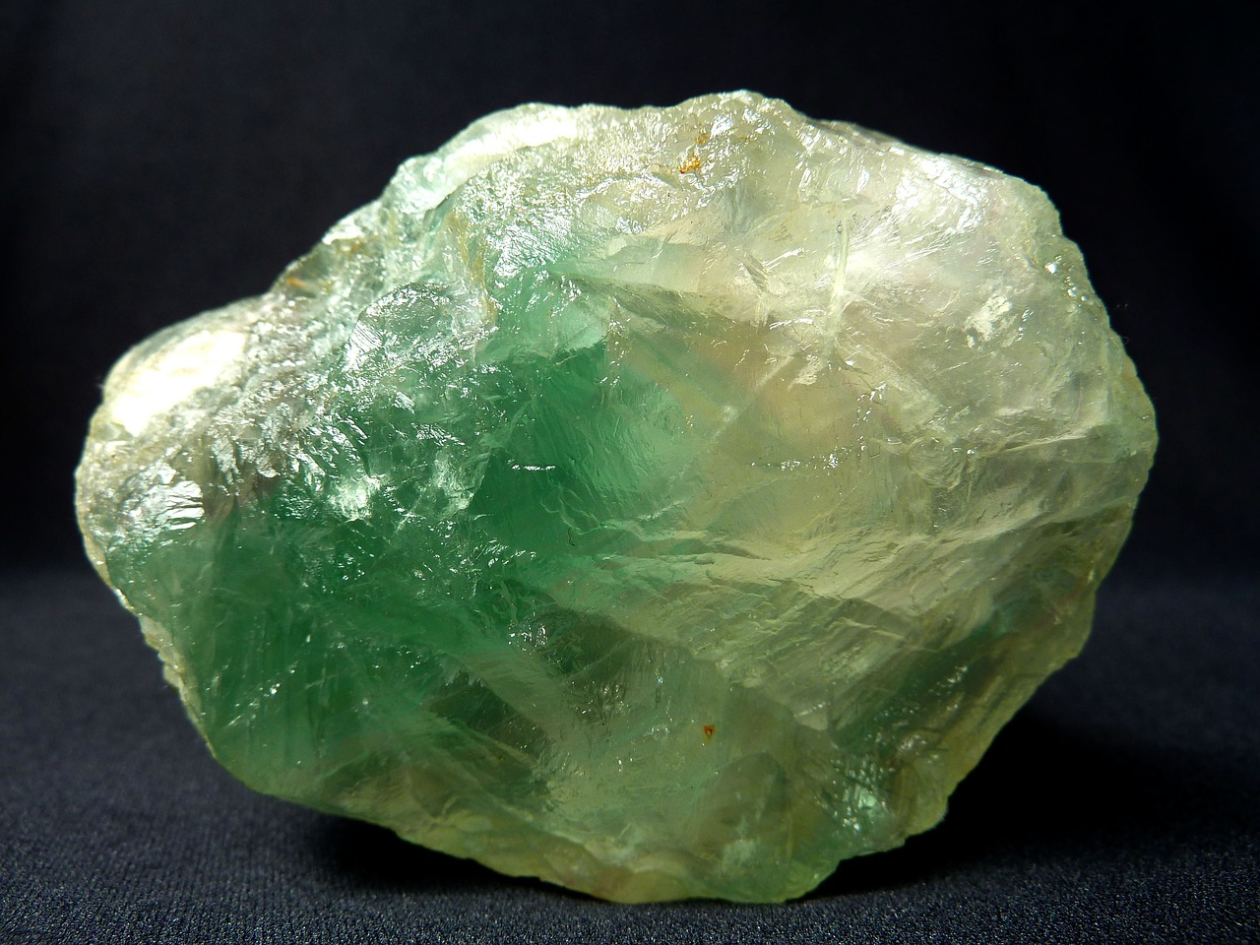
This picture shows a mineral called fluorite. The chemical name for this mineral is calcium fluoride (CaF₂) Fluorite is an ore from which we can extract calcium metal.
Discuss:
What should a scientist react this substance with in order to extract the calcium metal?
Notes:
Only sodium or potassium could be used to displace calcium from its compound.
Suggested guidance:
Talk tasks can be used in a variety of ways to suit the particular needs of the students you are teaching. Through exchanging views with others, students develop their understanding of the science beyond what could be achieved individually.
Science classrooms that successfully integrate talk have the following features:
Science talk is a regular feature of lessons and is woven into classroom activities.
Students are paired or grouped strategically by the teacher to ensure productive interaction. This might take into consideration the students’ proficiency of the English language, how encouraging they might be to peers and their attainment in the topic. It’s a good idea to consider these pairings in the class seating plan.
Students are encouraged and supported to talk, but are not forced to talk.
The teacher should take on the role of a facilitator, engaging with conversations where necessary and encouraging or steering the conversation where needed.
Students are encouraged to use the language they have to express their ideas (e.g., everyday language, imperfect English, native language), but also to incorporate science specific terminology where this is more accurate or has been taught.
6. Scientifically inaccurate ideas are not dismissed by the partner or teacher; open discussion and further investigation are relied on to help students construct ideas that support them to progress in their scientific understanding.
7. Guidelines for behaviour during talk tasks are explicit and frequently reviewed. Rules for students might be:
Listen carefully to your partner
Take turns talking.
Speak one at a time, without interrupting.
Politely agree or disagree and explain why.
Politely point out if your partner has used a scientific word incorrectly, if they have explained the science incorrectly, or if there is a more accurate way to describe something.
If confused, ask questions.
Stay focused on the discussion topic.
Respond to one another.
Image from pixabay

Slide 13
Predict the products of these reactions.
Potassium
Sodium
Calcium
Ore/mineral | Reacting with | Prediction
Iron oxide | carbon
Magnesium oxide | carbon
Gold | carbon
Potassium oxide | carbon
Magnesium
iron + carbon dioxide
Aluminium
Carbon
no reaction
Zinc
Iron
no reaction
Tin
no reaction
Lead
Hydrogen
Copper
Silver
Gold
Platinum

Slide 14
Drill
What is the type of reaction used to extract the least reactive metals from their ores?
What is the most reactive metal in the reactivity series?
Give one observation a student would make in the reaction between zinc and copper sulfate.
Define oxidation.
Define reduction.
Which metals can copper displace from a compound?
Write an equation for the displacement reaction between carbon and copper oxide.
Explain why there would be no reaction between carbon and aluminium oxide.
Which is less reactive, zinc or lead?
Write a balanced chemical equation for the reaction between carbon and copper oxide (CuO).
Notes:
Purpose: This is a knowledge drill. The purpose of this is to check that the critical knowledge is secure before pupils move onto independent practice.
Suggested guidance: There are a range of ways this could be done depending on time and ability range of the class:
Mini whiteboards
As full sentences in exercise books
As short answers in exercise books
In the pupil workbook
As pair talk
As cold call

Slide 15
Drill answers
Displacement reactions
Potassium is the most reactive metal in the reactivity series.
Zinc would shrink/not be visible. Copper metal would be seen.
Oxidation is the addition (gain) of oxygen
Reduction is the loss of oxygen.
Copper can displace any metals less reactive that itself.
copper oxide + carbon → copper + carbon dioxide.
Carbon cannot displace aluminium from aluminium oxide because carbon is less reactive than aluminium
Lead is less reactive than zinc.
2CuO + C → 2Cu + CO₂
Notes:
Purpose: This is a knowledge drill. The purpose of this is to check that the critical knowledge is secure before pupils move onto independent practice.
Suggested guidance: There are a range of ways this could be done depending on time and ability range of the class:
Mini whiteboards
As full sentences in exercise books
As short answers in exercise books
In the pupil workbook
As pair talk
As cold call

Slide 16

I: Describing displacement reactions
Old windows sometimes contain lead.
1. What are the products of this reaction?
2. Write a word equation to describe this reaction.
3. Write a balanced chemical equation for this reaction.
4. Give one observation that would be made that would indicate that a reaction is happening.
One step in the manufacture of lead is the reduction of lead oxide (PbO) with carbon.
Lead and carbon dioxide are the products of this reaction.
lead oxide + carbon → lead + carbon dioxide
2PbO + C → 2Pb + CO₂
Bubbles of gas would be seen as carbon dioxide is produced
Notes:
Purpose: The I-We-You section aims to support pupils to build skills that they most commonly need when answering questions associated with this knowledge in the assessment. This section is also used to interleave other content we expect pupils to know at this stage of their education in order that they build a big picture of the science they are learning.
For the ‘I’ activity, the teacher should model how to answer the question. They can do this by narrating their thinking process aloud, and making links to learning earlier in the lesson explicit.
For the ‘we’ activity, the teacher and students work though a similar example together, in order to prepare students to be able to answer a similar question independently.
Opportunities for the ‘you’ activity – independent practise – occur in the activity portion of the lesson once the student is secure enough to process independently.

Slide 17
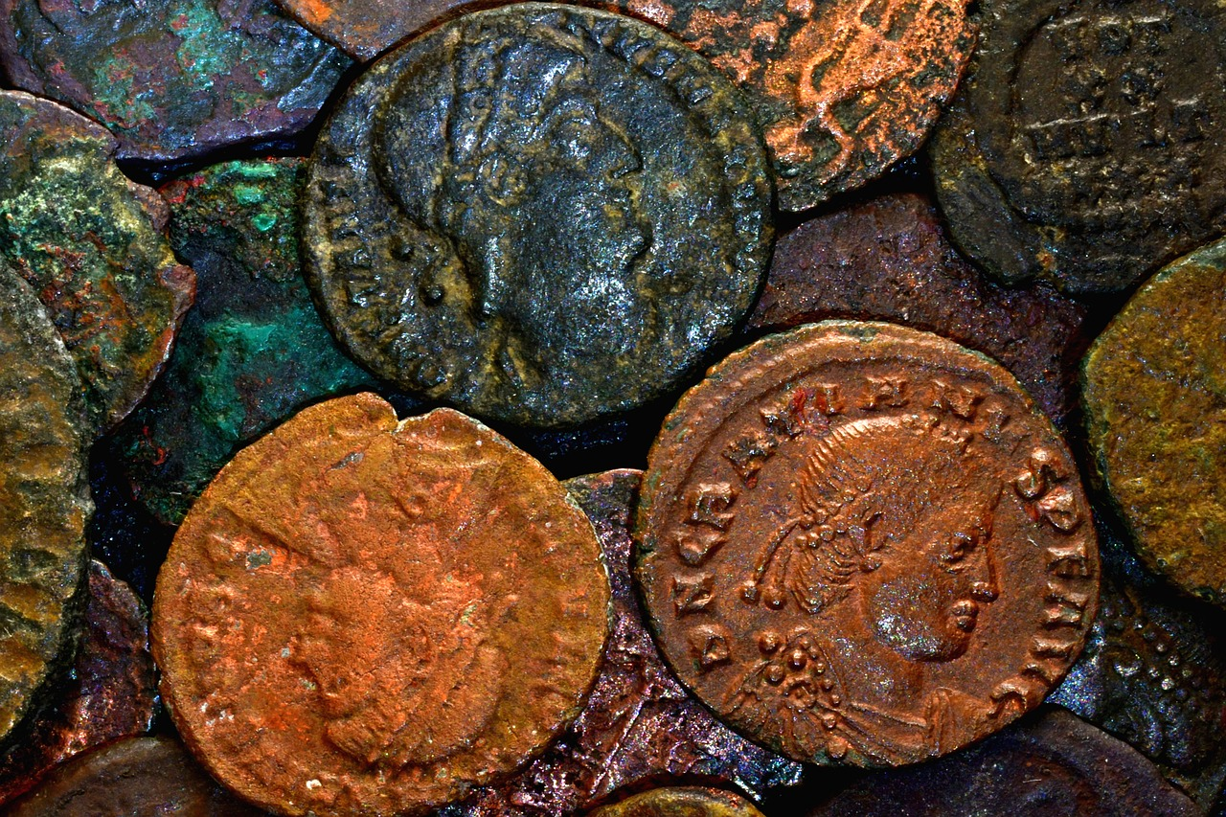
We: Describing displacement reactions
Ancient Roman coins made of copper have been found.
One step in the manufacture of copper is the reduction of capper oxide (CuO) with carbon.
1. What are the products of this reaction?
2. Write a word equation to describe this reaction.
3. Write a balanced chemical equation for this reaction.
4. Give one observation that would be made that would indicate that a reaction is happening.
Copper and carbon dioxide are the products of this reaction.
copper oxide + carbon → copper + carbon dioxide
2CuO + C → 2Cu + CO₂
Bubbles of gas would be seen as carbon dioxide is produced
Notes:
Purpose: The I-We-You section aims to support pupils to build skills that they most commonly need when answering questions associated with this knowledge in the assessment. This section is also used to interleave other content we expect pupils to know at this stage of their education in order that they build a big picture of the science they are learning.
For the ‘I’ activity, the teacher should model how to answer the question. They can do this by narrating their thinking process aloud, and making links to learning earlier in the lesson explicit.
For the ‘we’ activity, the teacher and students work though a similar example together, in order to prepare students to be able to answer a similar question independently.
Opportunities for the ‘you’ activity – independent practise – occur in the activity portion of the lesson once the student is secure enough to process independently.

Slide 18

You: Describing displacement reactions
Iron is sometimes used to make railings.
1. What are the products of this reaction?
2. Write a word equation to describe this reaction.
3. Write a balanced chemical equation for this reaction.
4. Give one observation that would be made that would indicate that a reaction is happening.
One step in the manufacture of lead is the reduction of iron oxide (Fe₂O₃) with carbon.
Iron and carbon dioxide are the products of this reaction.
iron oxide + carbon → iron + carbon dioxide
2Fe₂O₃ + 3C → 4Fe + 3CO₂
Bubbles of gas would be seen as carbon dioxide is produced
Notes:
Purpose: The I-We-You section aims to support pupils to build skills that they most commonly need when answering questions associated with this knowledge in the assessment. This section is also used to interleave other content we expect pupils to know at this stage of their education in order that they build a big picture of the science they are learning.
For the ‘I’ activity, the teacher should model how to answer the question. They can do this by narrating their thinking process aloud, and making links to learning earlier in the lesson explicit.
For the ‘we’ activity, the teacher and students work though a similar example together, in order to prepare students to be able to answer a similar question independently.
Opportunities for the ‘you’ activity – independent practise – occur in the activity portion of the lesson once the student is secure enough to process independently.
Image source: Pixabay

Slide 19
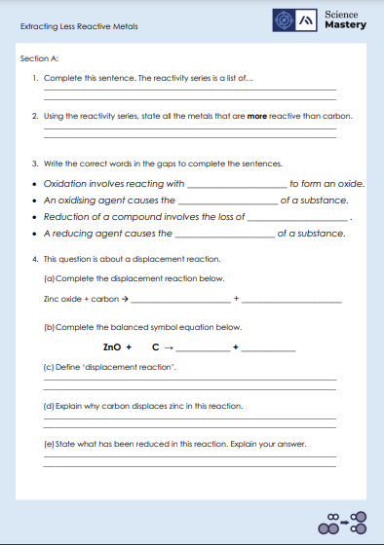
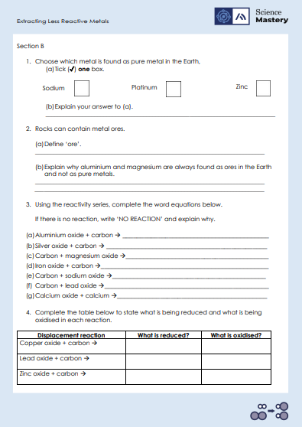
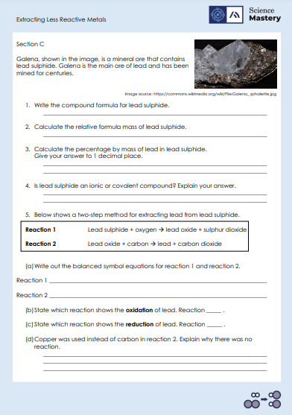
Activity

Slide 20
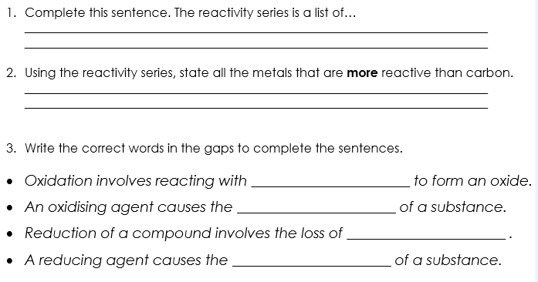
Answers – Section A
substances/metals arranged from most reactive at the top and least reactive at the bottom.
Potassium, sodium, calcium, magnesium, aluminium
oxygen
oxidation
oxygen
reduction

Slide 21
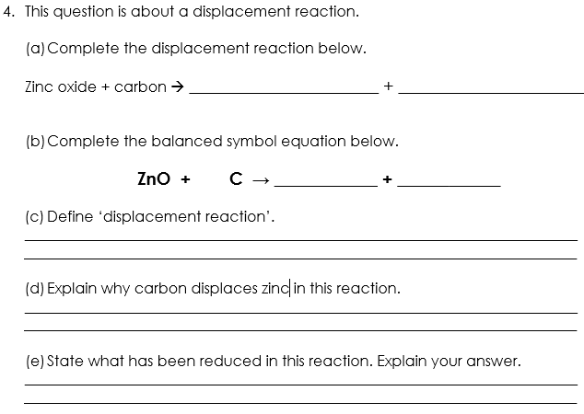
Answers – Section A
zinc
carbon dioxide
2
2
Zn
CO₂
A reaction where a more reactive element replaces a less reactive element in a compound.
Carbon is higher on the reactivity series than zinc which means it is more reactive so displaces zinc.
Zinc oxide has been reduced because it has lost oxygen.

Slide 22
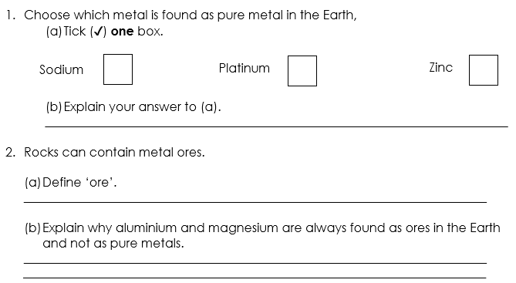
Answers – Section B
✓
Platinum is very unreactive so is found as a pure metal.
A rock that contains enough metal compound to extract the metal.
They are reactive which means they react with other elements to form compounds.

Slide 23
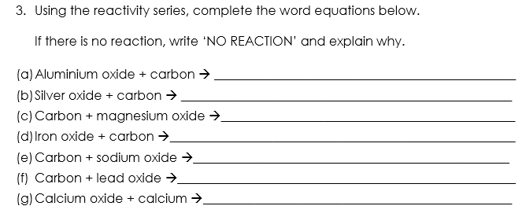
Answers – Section B
NO REACTION – Al is more reactive than C
silver + carbon dioxide
NO REACTION – Mg is more reactive than C
iron + carbon dioxide
NO REACTION – Na is more reactive than C
lead + carbon dioxide
NO REACTION – Ca is more reactive than C

Slide 24
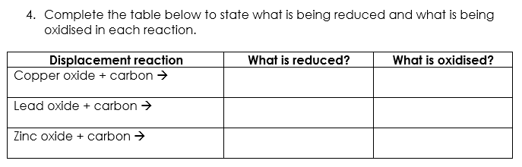
Answers – Section B
Copper oxide
Carbon
Lead oxide
Carbon
Zinc oxide
Carbon

Slide 25
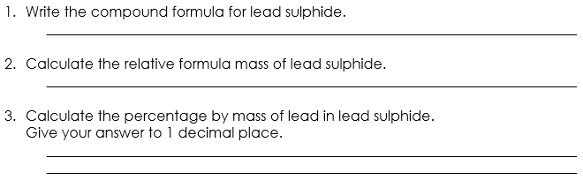
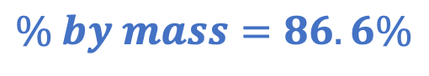
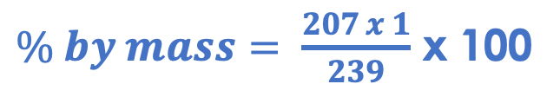
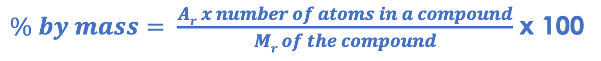
Answers – Section C
PbS
A_{r} Pb = 207
M_{r} 207 + 32 = 239
S = 32
$\% by mass= \frac{Ar x number of atoms in a compound}{Mr of the compound}$ x 100
$\% by mass= \frac{207 x 1}{239}$ x 100
$$\% by mass=86.6\%$$
Ionic because lead is a metal and sulphur is a non-metal. Lead forms a positive ion and sulphur forms a negative ion which is required for an ionic bond.

Slide 26
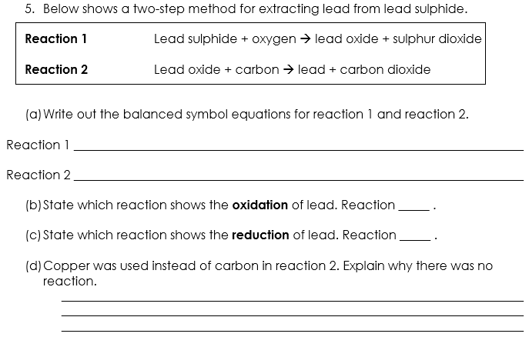
Answers – Section C
2 PbS + 3 O₂ → 2 PbO + 2 SO₂
2 PbO + C → 2 Pb + CO₂
1
2
Copper is less reactive than lead so a displacement reaction will not happen.

Slide 27
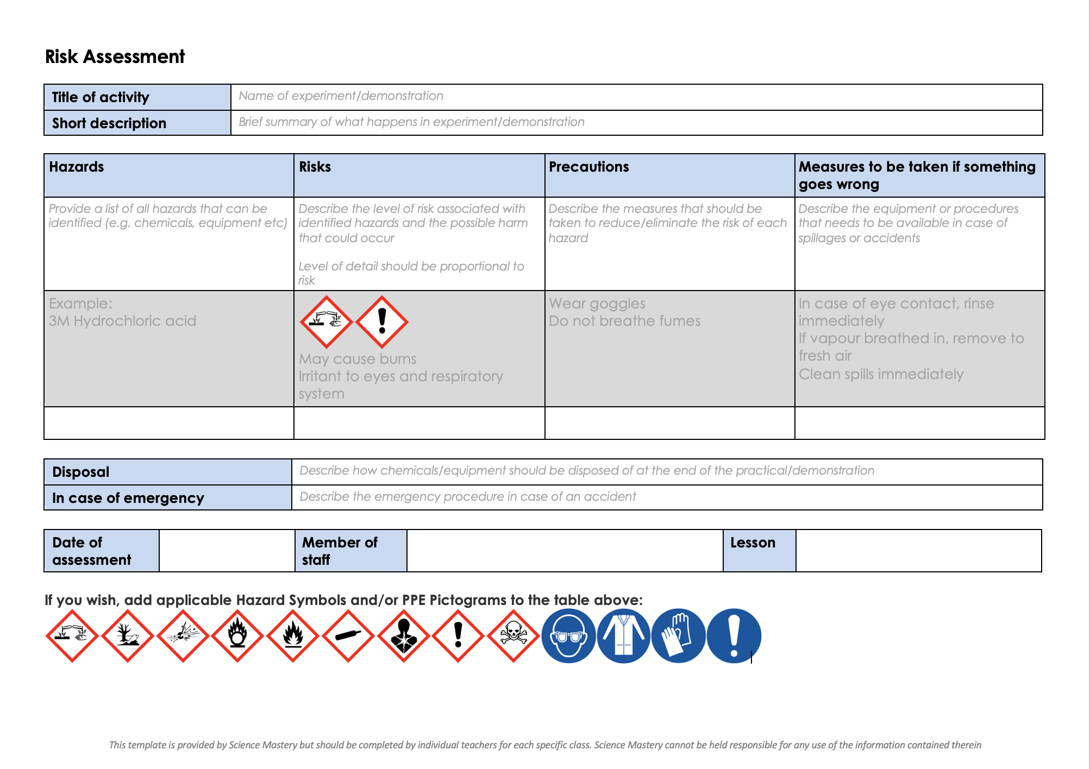
Risk Assessment
A risk assessment must be completed for this practical
The template risk assessment can be found here.

Slide 28
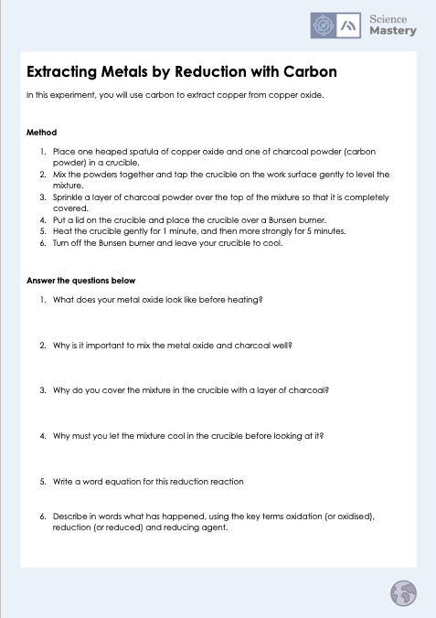
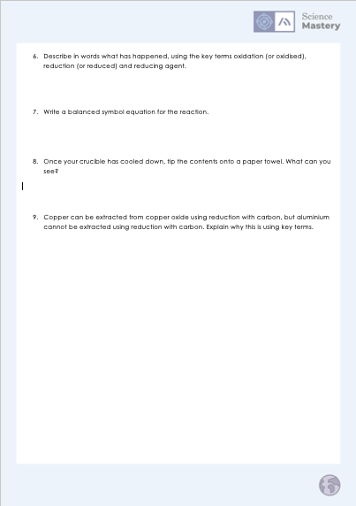
Extracting Metals by Reduction with Carbon activity

Slide 29

Explain: to use scientific understanding to make something clear or state the reason for something happening
Example question:
To ‘explain’ your answer should:
Begin with a scientific statement.
Use ‘this means that’, ‘because’ or ‘so’ to link your statement to the question.
Copper sulfate is a blue liquid. When it reacts with magnesium, the blue colour disappears.
Explain why the blue colour disappears during this reaction.
Model answer:
Magnesium is more reactive than copper
Because it is higher up on the reactivity series
Therefore, magnesium will react with copper sulfate
Magnesium displaces copper
In this reaction, the products are magnesium sulfate and copper
As the copper sulfate reacts, there is less copper sulfate in the test tube and more magnesium sulfate
Therefore, the blue colour disappears
Notes:
This slide models the process of answering an explain question.
Firstly, students are presented with a generic explain question, along with a model answer. Students are also given some simple guidance to follow for producing their own describe answer.
The generic question and answer should be used by the teacher to remind students of
the key features of a great answer
how to structure their answer
why the model answer is a good example
Following this, students will be required to apply this process to answer their own explain question, which will appear in place of the generic questions. This explain question will be specific to the topic students are learning about in the lesson. Give students time to write their own answer to this, ensuring that they use the guidance provided. To further scaffold this task for students, it may be appropriate to:
pair students up to write an answer together
list for students the key words you would like them to include in the answer
provide a writing frame or ‘points to include’ for students
A model answer for this question will appear. Teachers should review the model answer with students by referencing the guidance in the green box. For example ‘we can see item 1 in the guidance is to begin with a scientific statement. Notice in the model answer here we have done just that’. Or ‘item 2 in the guidance here says that we should use a linking statement in the answer. Has this been achieved in the model answer? Where can we see this?’.

Slide 30
Answer the questions below.
Which answer correctly describes the reaction between lithium and aluminium oxide?
A. lithium + aluminium oxide -> lithium aluminium + oxygen
B. lithium + aluminium oxide -> lithium oxide + aluminium
C. lithium and aluminium oxide would not react
✓
2. Which of the metals below would be found as a pure metal in the Earth's crust?
A. Aluminium
B. Gold
C. Copper oxide (an ore)
✓
3. The combustion of magnesium can be represented by the following equation: 2Mg + O2 -> 2MgO. What type of reaction is this?
A. A reduction reaction
B. An oxidation reaction
C. A neutralisation reaction
✓
Notes:
Q1. Answer: B
If students answer A, they recognise that displacement is occurring, however they have displaced the oxygen instead of the metal. To fix-it, remind students that in displacement reactions the metal replaced another metal. Give students some example displacement reaction equations to complete.
If students answer C, they either think that lithium is less reactive than aluminium, or the think that a more reactive metal cannot displace a less reactive metal. To fix-it, remind students to refer to their reactivity series handout. Remind students that more reactive metals displace less reactive metals. Give students some more practise displacement reaction equations to complete.
Q2. Answer: B
If students answer A, they have not grasped that only the very least reactive metals are found as pure metals in the Earth’s crust. To fix-it, use the reactivity series to show students which metals are found as pure metals in the Earth’s crust.
If students answer C, they have confused the term ‘ore’ with ‘metal’. Although ores are also found in the Earth’s crust, they are not pure metals (they contain enough metal to be extracted economically). To fix-it, remind students of the definition of an ore, with some examples. Show the formula of a common ore and ask students to explain why this is different to a pure metal. A particle diagram may be helpful to illustrate this point.
Q3. Answer: B
If students answer A, they may have mixed up oxidation reaction with reduction reaction. To fix-it, remind students that in oxidation reactions, oxygen is added to something (hence the name), and therefore reduction is the opposite. Show some equations of oxidation and reduction reactions so that students can see this difference clearly – pointing out where oxygen is added or removed.
If students answer C, they may have guessed an answer. They do not recognise that oxygen has been added (and therefore have not grasped the idea of an oxidation reaction), and also are unable to recognise a neutralisation reaction as occurring between acids and alkalis and producing salt and water. To fix-it, remind students that in oxidation reactions, oxygen is added to something (hence the name), and therefore reduction is the opposite. Show some equations of oxidation and reduction reactions so that students can see this difference clearly – pointing out where oxygen is added or removed. Show students some examples of neutralisation reactions, pointing out the acid and alkali and common products. Ask students to identify the type of reaction from a list of equations.

Slide 31
Lesson C4.2.2
What was good about this lesson? | What can we do to improve this lesson?
Send us your feedback by clicking this link
or by emailing sciencemastery@arkonline.org
Thank you!

